Slide 1
Software Testing and Quality Assurance
Haiming Liu
liuhaiming@bjtu.edu.cn
School of Software Engineering
Beijing Jiaotong University

Slide 2
Equivalence Partitioning
Boundary Value Analysis

Slide 3
Equivalence Partitioning
Idea is to partition the input space into a number of equivalence classes such that one could expect, based on the specification, that every element of a given class would be ‘‘handled’’ (i.e., mapped to
an output) in the same manner
(either correctly or incorrectly),
thus reducing the total number of test cases that must be developed.
Two types of classes are identified:
valid (corresponding to inputs deemed valid from the specification)
invalid (corresponding to inputs deemed erroneous from the specification)
Notes:
等价类划分其思想是将输入空间根据规范划分为若干等价类，这样可以期望给定类的每个元素都以相同的方式“处理”（即映射到输出）（正确或错误），从而减少必须开发的测试用例总数。

Slide 4
Equivalence Partitioning
Divide all possible inputs into classes (partitions) such that : There is a finite number of input equivalence classes
You may reasonably assume that
The program behaves analogously for inputs in the same class
One test with a representative value from a class is sufficient
If the representative detects a fault, then other class members would detect the same fault
i₁
i₄
i₂
i₃
all inputs
Notes:
将所有可能的输入划分为类（分区），以便：有有限个输入等价类

Slide 5
Equivalence Partitioning
1. If input is a range, one valid and two invalid equivalence classes:
less than range
in range
greater than range
2. If input is a specific value, one valid and two invalid equivalence classes:
less than value
value
greater than value
3. If input is a set of related values, one valid and one invalid class:
not member of set
member of set
4. If input is Boolean, one valid and one invalid class:
nonBoolean
Boolean

Slide 6
Black-Box testing - Boundary Value Analysis (BVA)
errors hide in the corner
A technique based on identifying, and generating test cases to explore boundary conditions.
Boundary conditions are an extremely rich source of errors.
Natural language based specifications of boundaries are often ambiguous, as in ‘‘for input values of X between 0 and 40,...’’
May be applied to both input and output conditions.
Also applicable to white box testing.
more errors occur at the boundaries of an input domain than in the “center”
Notes:
错误隐含在角落 errors hide in the corner

Slide 7
Types in Boundary
First/last
Min/Max
Star/Finish
Empty/Full
Slower/Faster
Largest/Smallest
Over/Under
Shortest/Longest
… …
Numeric
Character
Position
Quantity
Speed
Location
Size

Slide 8
Examples of possible boundary conditions
Limits on input data – size, type
Limits on output data- size, type
Look for limits such as
First-1/Last+1
Start-1/Finish+1
Min-1/max+1
Less than empty/ more than full
just Over/Just Under
etc.
Don’t hesitate to choose data outside boundaries, even when it seems absurd.
Notes:
可能的边界条件示例，越界测试。

Slide 9
Boundary Values
Based on experience / heuristics :
Testing boundary conditions of eq. classes is more effective i.e. values directly on, above, and beneath edges of classes
Choose input boundary values as tests in input classes instead of, or additional to arbitrary values
Choose also inputs that invoke output boundary values ( values on the boundary of output classes )
Example strategy as extension of equivalence partitioning:
choose one (n) arbitrary value(s) in each eq. class
choose values exactly on lower /upper boundaries of eq. class
choose values immediately below /above each boundary ( if applicable )
Notes:
基于经验/启发：
测试等式类的边界条件更有效，即直接在类的边上、边上和边下的值
选择输入边界值作为输入类中的测试，而不是作为任意值的附加值
同时选择调用输出边界值（输出类边界上的值）的输入

Slide 10
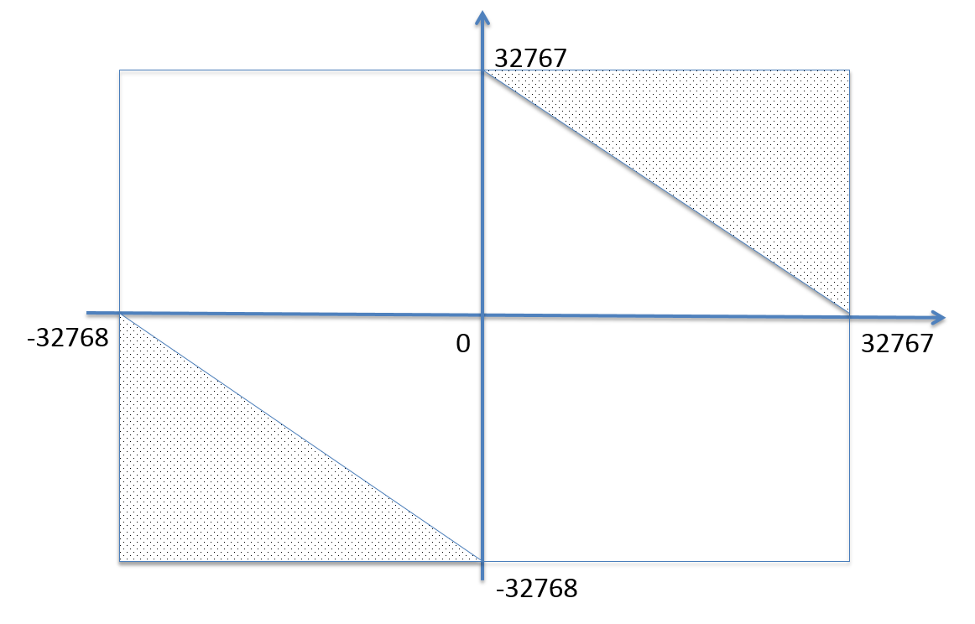
16 bit

Slide 11
Guidelines for Identifying Boundary Values
1. If the input range is bounded by a and b, then use a, b, and values just above and just below a and b, respectively.
a
b
2. If the input is a number of values, use the minimum and maximum of the values and values just above and just below them, respectively.
a
b
3. Apply guidelines 1 and 2 to create output values at the minimum and maximum expected values.
4. If data structures have boundaries, test these boundary values and values just above and just below them, respectively.
e.g., for an array of bounds 1 to 10
— test array index equal to 0, 1,2, 9, 10, 11

Slide 12
BVA Example
Test a function for calculation of absolute value of an integer
Valid equivalence classes :
Condition Valid eq. classes Invalid eq. Classes
particular abs < 0, >= 0
Test cases :
class x < 0, arbitrary value: x = -10
class x >= 0, arbitrary value x = 100
classes x < 0, x >= 0, on boundary : x = 0
classes x < 0, x >= 0, below and above: x = -1, x = 1

Slide 13
BVA Example
Test a function which limit user input to positive integer (6-digit)
Test cases :
Class arbitrary value: X1 = 123123
Class arbitrary value: X2 = 12345
Class boundary value: X3 = 999999
Class boundary value: X4 = 1
Class boundary value: X5 = 0
Class invalid value: X6 = -1
Class invalid value: X7 = asdasd
Others?
Class invalid value: X8 = 000123
X9 = asd123
X10 = Empty

Slide 14
BVA Example
If input is a 5-digit integer between 10,000 and 99,999

Slide 15
BVA Example
Individual Income Tax Specification:
If gross pay is no more than ￥36,000, the tax is 3%.
If gross pay is more than ￥36,000, but no more than ￥144,000, the tax is 10%.
If gross pay is more than ￥ 144,000, but no more than ￥300,000, the tax is 20%.
If gross pay is more than ￥ 300,000, but no more than ￥420,000, the tax is 25%.
If gross pay is more than ￥420,000 the tax is 45%.
Notes:
为以下程序规范片段标识（多组不相交的）等价类。
个税：

Slide 16
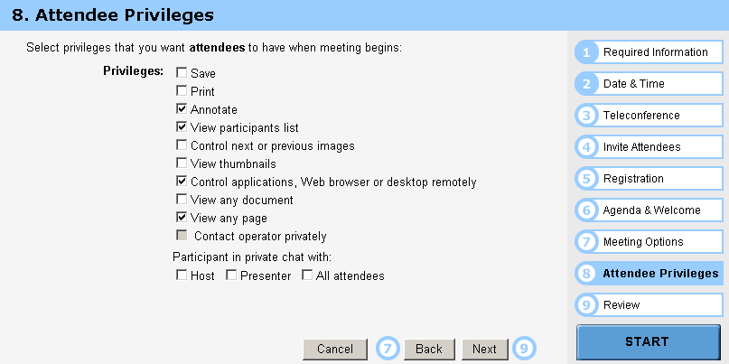
BVA Example

Slide 17
Guidelines for choosing Equivalence classes For Data Testing
Identify sub-boundary conditions or internal boundary conditions
Some limits may not be apparent to the general end user.
To locate some of these, you may need to talk with programmers.
Example: Powers-of-two boundary conditions
Notes:
确定次边界条件或内部边界条件

Slide 18

Power-of-Two
Binary: 0 and 1, byte is made up of 8 bits, word is made up of 4 bytes, …
Term | Range or Value
Bit Nibble Byte Word Kilo Mega Giga Tera | 0 or 1 0-15 <Half byte> 0-255 0-4294967295 1024 1048576 1073741824 1099511627776
位
半字节
字节
字
千
兆
吉
太

Slide 19
EXAMPLE: Powers-of-Two
Often a programmer will handle data differently depending upon its size.
Example: Communications software where with limited bandwidth, we try to keep the size of data being transmitted low.
Program transmits 256 commands, but uses only a nibble (4 bits) to encode the 15 most commonly used commands.
Thus, there is an internal boundary between the 4th and 5th bit
Might try transmitting 3, 4, 5 bits in addition to ones determined by the stated boundary conditions of 1 and 8 bits.
Notes:
程序员通常会根据数据的大小来处理不同的数据。

Slide 20
An Example: A flight simulator
Assume the user can control the height of the plane, determine what those limits are:
Not specified?
Why not?
Nothing in a computer is infinite!
Try flying
Below ground
In outer space
Through a mountain (or some other object)

Slide 21
ASCII Table
Character | ASCII Value | Character | ASCII Value
Null Space / 0 1 2 9 ： @ A | 0 32 47 48 49 50 57 58 64 65 | B Y Z [ ‘ a b y z { | 66 89 90 91 96 97 98 121 122 123
Notes:
另一个常见的次边界条件是ASCII字符表

Slide 22
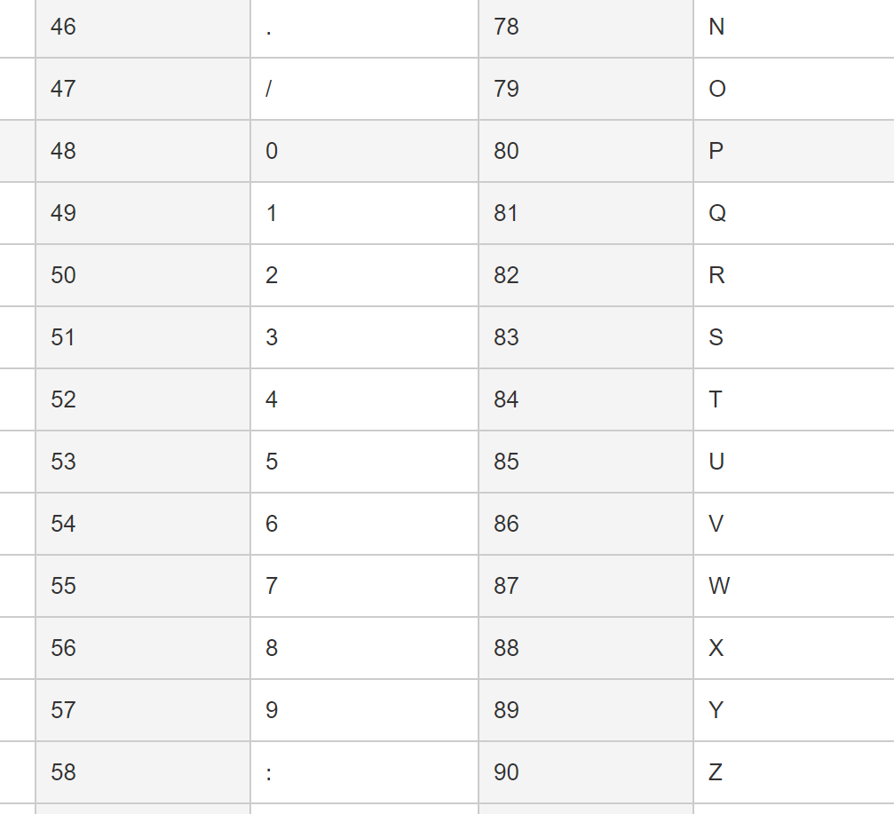
ASCII Encoding Always Produce Sub-Boundary Conditions
The ASCII code is 8 bits.
If numeric digits are to be input,
check just out of range with the ‘/’ and ‘:’
Notes:
ASCII码是8位。

Slide 23
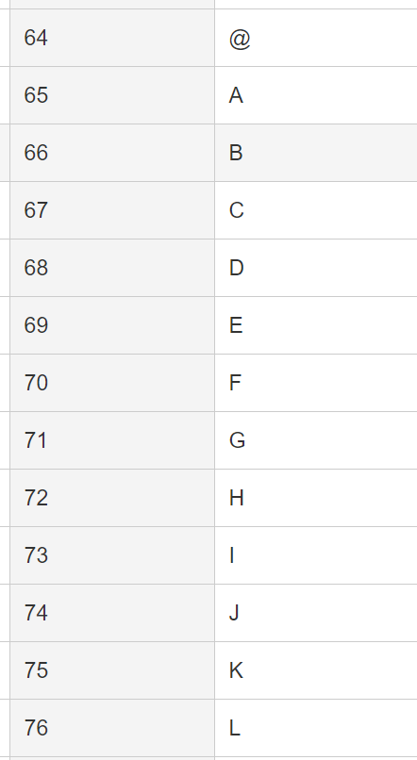
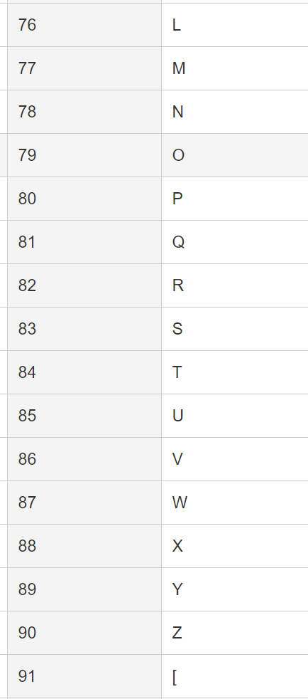
ASCII Encoding Always Produce Sub-Boundary Conditions
The ASCII code is 8 bits.
If capital letters are to be input,
check just out of range with the ‘@’ and ‘[‘
Notes:
ASCII码是8位。

Slide 24
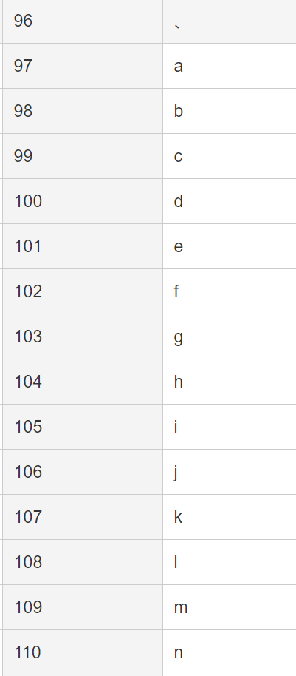
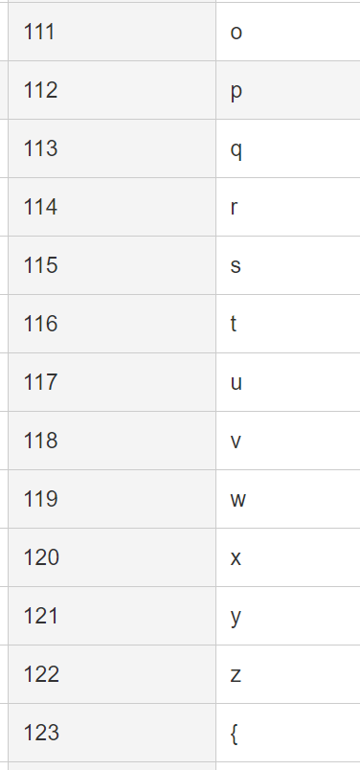
ASCII Encoding Always Produce Sub-Boundary Conditions
The ASCII code is 8 bits.
If lower case letters are to be input,
check just out of range with the forward quote and the ‘{‘.
Notes:
ASCII码是8位。

Slide 25
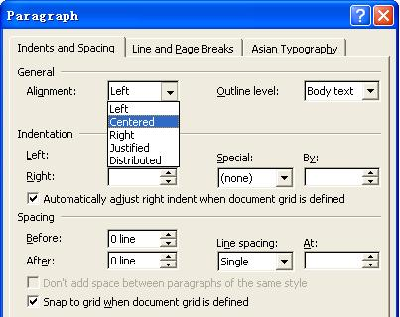
Text-box Field
Default
Empty
Blank
Null
Zero
None

Slide 26
Further Partitioning Possibilities
Check default, empty, blank, null, zero, and no data.
- If nothing is entered, what happens?
- Default set?
- Error message?
- Hung program?
Check invalid, wrong, incorrect, and garbage data.
- Users WILL use the software incorrectly.
- Data loses or crashes are blamed on the software, always --- not the user
- Have fun with this one --- devious, tricky, and nasty are good traits for a tester!
Notes:
进一步划分的可能性

Slide 27

主观题
Equivalence Partitioning
10分
北京市2022年度考公，规定报名者年龄应在18周岁以上、35周岁以下，出生年月规定日期由6位数字组成，前4位表示年份，后2位表示月份。出生年月不在上述范围内，将拒绝接受，并显示“年龄不合格”等出错信息。
1、划分等价类
2、进行边界值分析
3、设计测试用例
作答
Notes:
(1985年11月至2003年11月期间出生)
画表格

Slide 28
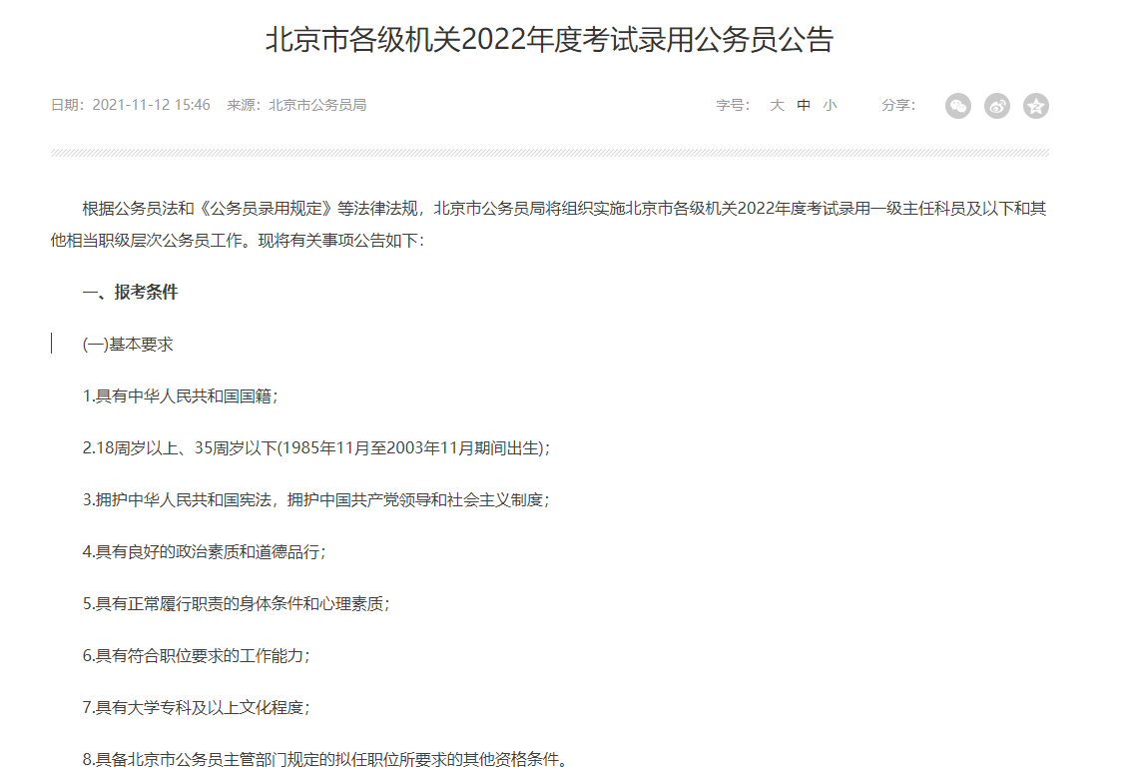
Test
北京市2022年度考公，规定报名者年龄应在18周岁以上、35周岁以下，出生年月规定日期由6位数字组成，前4位表示年份，后2位表示月份。出生年月不在上述范围内，将拒绝接受。
Notes:
(1985年11月至2003年11月期间出生)

Slide 29
划分等价类
北京市2022年度考公，规定报名者年龄应在18周岁以上、35周岁以下，出生年月规定日期由6位数字组成，前4位表示年份，后2位表示月份。出生年月不在上述范围内，将拒绝接受。
Conditions | Valid | Invalid
输入数字 | 6位数字（1） | 大于6位（2） 小于6位（3） 非数字（4）
年份 | 1985-2003（5） | 大于2003（6） 小于1985（7）
月份 | 01-12（8） | 小于01（9） 大于12（10）
Notes:
(1985年11月至2003年11月期间出生)
Class arbitrary value
Class boundary value

Slide 30
边界值分析
北京市2022年度考公，规定报名者年龄应在18周岁以上、35周岁以下，出生年月规定日期由6位数字组成，前4位表示年份，后2位表示月份。出生年月不在上述范围内，将拒绝接受。
 |  | Boundary Value
输入数字 | 6位数字（1） | 4/5/6
年份 | 1985-2003（5） | 1984/1985/1986 2002/2003/2004
月份 | 01-12（8） | 00/01/02 11/12/13
Notes:
(1985年11月至2003年11月期间出生)
Class arbitrary value
Class boundary value

Slide 31
测试用例
北京市2022年度考公，规定报名者年龄应在18周岁以上、35周岁以下，出生年月规定日期由6位数字组成，前4位表示年份，后2位表示月份。出生年月不在上述范围内，将拒绝接受。
No | Description | Input | Expected Output
Notes:
(1985年11月至2003年11月期间出生)
Class arbitrary value
Class boundary value

Slide 32
主观题
Equivalence Partitioning
10分
The fuel surcharge:
From 0:00 on Oct 17, 2022, the fuel surcharge has been adjusted. The adjusted standard is that each passenger will be charged a fuel surcharge of 80 yuan for segments below 800 kilometers (inclusive), and each passenger will be charged 140 yuan for segments of more than 800 kilometers, which is 20 yuan and 60 yuan lower than before.
The program will output the fuel surcharge based on the input value.
作答

Slide 33
Test
The fuel surcharge:
From 0:00 on Oct 17, 2022, the fuel surcharge has been adjusted. The adjusted standard is that each passenger will be charged a fuel surcharge of 80 yuan for segments below 800 kilometers (inclusive), and each passenger will be charged 140 yuan for segments of more than 800 kilometers, which is 20 yuan and 60 yuan lower than before.
The program will output the fuel surcharge based on the input value.
Conditions | Valid | Invalid
Time | >=0:00 on Oct 17, 2022（1） < 0:00 on Oct 17, 2022（2） | Illegal time（3）
Distance | >=800KM（4） <800KM（5） | Illegal distance（6）
Notes:
(1985年11月至2003年11月期间出生)

Slide 34
Homework II
Q1: The New Telephone Company has the following rate structure for long distance calls:
Q2: Imagine a program which reads in the length of three sides of a triangle and outputs a message naming the kind of triangle: EQUILATERAL, ISOSCELES, or SCALENE.
Exercise: Write a complete set of Black Box test cases (including equivalence classes and boundary value analysis) for testing of the program which solves the problem above.
After equivalence classes and boundary value analysis, please create a table like the one below. Include a complete description field for the purpose of the each test case.

Slide 35
To be continued… See you next week

